Slide 1
Adaptations of animals on the rocky shore.

Slide 2
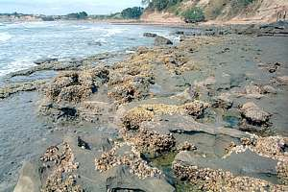
What could be affecting this environment???

Slide 3
Abiotic factors that influence distribution on the rocky shore.
Salinity
Temperature
Moisture levels/ amount of time immersed by tide.
Wind exposure
Wave exposure
Light intensity

Slide 4
Adaptations
Adaptations are generally:
Structural - eg. thick, impermeable shells to reduce water loss and radiation effects.
Behavioural - eg. seeking small crevices for shelter to reduce the drying effects of the wind.
Physiological - eg. an ability to lower metabolic rates during exposed periods to minimise oxygen consumption

Slide 5
Biotic factors that influence distribution on the rocky shore.
Competition
Predation
Food availability

Slide 6
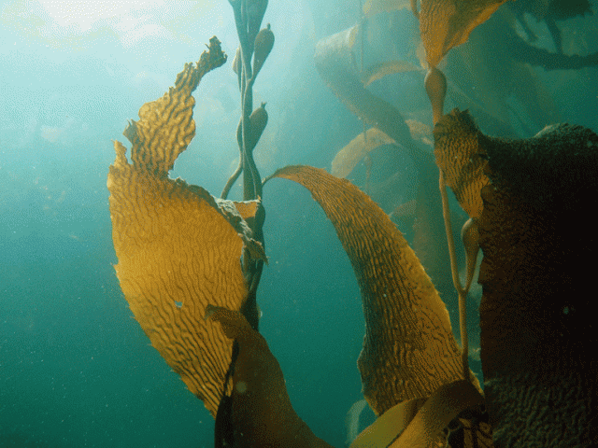
Bladder Kelp
Need sunlight for photosynthesis.
Strong attachment to rocks
High demand for water
Thick, tough leaves to cope with strong waves.
Bladders for flotation

Slide 7
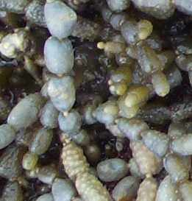
Neptunes Neclace
Tough modified leaves.
Air filled bladders to enable flotation.
Strong attachments to rocks.

Slide 8
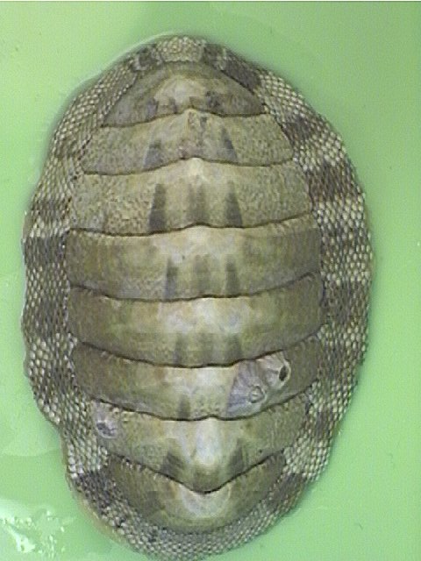
Chitons
Very strong attachment to rocks- foot.
Attachment avoids being washed off rocks/ picked off- predation
Streamlined shape to prevent being washed off rocks

Slide 9
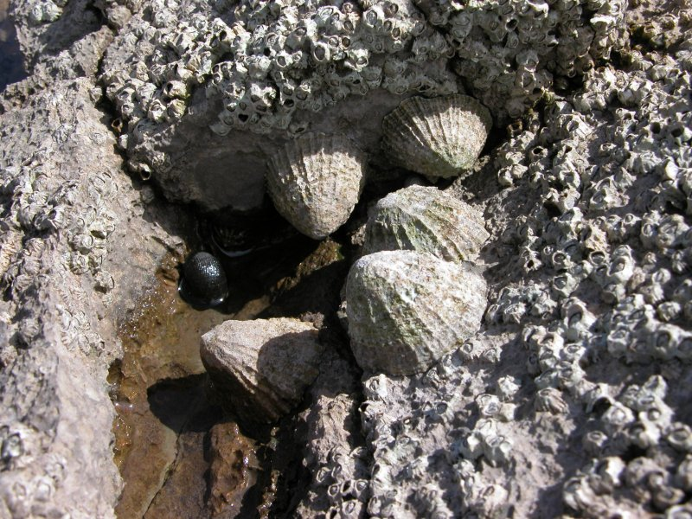
Limpets
Very strong attachment to rocks- foot.
Attachment avoids being washed off rocks/ picked off- predation
Streamlined shape to prevent being washed off rocks
Hard shell- protection from predation

Slide 10
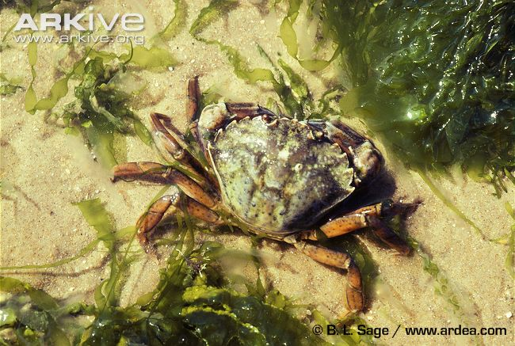
Crabs
Mobile- escape preds/ search out food.
Modified leg into claw for protection and territorial displays.
Streamlined shape to limit chances of being washed off rocks.
Behavoiral adaptions- burrowing and living under rocks
These help to avoid desiccation.

Slide 11
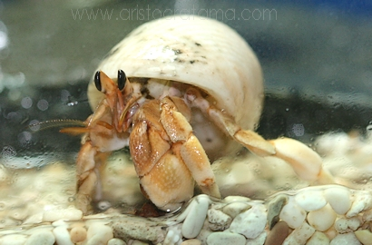
Hermit Crab
Mobile- escape preds/ search out food.
Modified leg into claw for protection and territorial displays.
Streamlined shape to limit chances of being washed off rocks.
Behavioural adaptations- burrowing and living under rocks
Shell provides protection/ camoflague

Slide 12
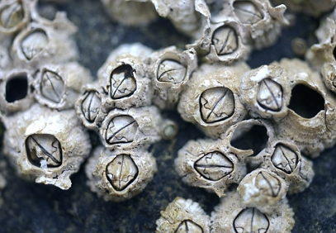
Barnacles
Strong attachment to rocks- glue
Hard shell- protection from predators/ desiccation
Free swimming larvae- distributed to reduce competition
Ability to close up shell when tide is out to prevent dehydration.

Slide 13
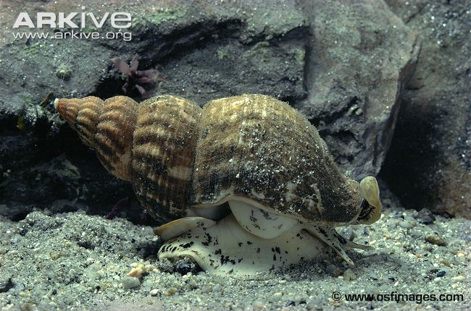
Whelk
Hard shell to avoid predation- eat barnacles.
Mobile foot that can be retracted to avoid desiccation.
Can close shell.
Food must hold to rocks to avoid being washed off
Sheltering behaviour

Slide 14
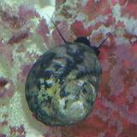
Snail (includes periwinkle)
Hard shell
Strong foot
Ability to close up to avoid desiccation.

Slide 15
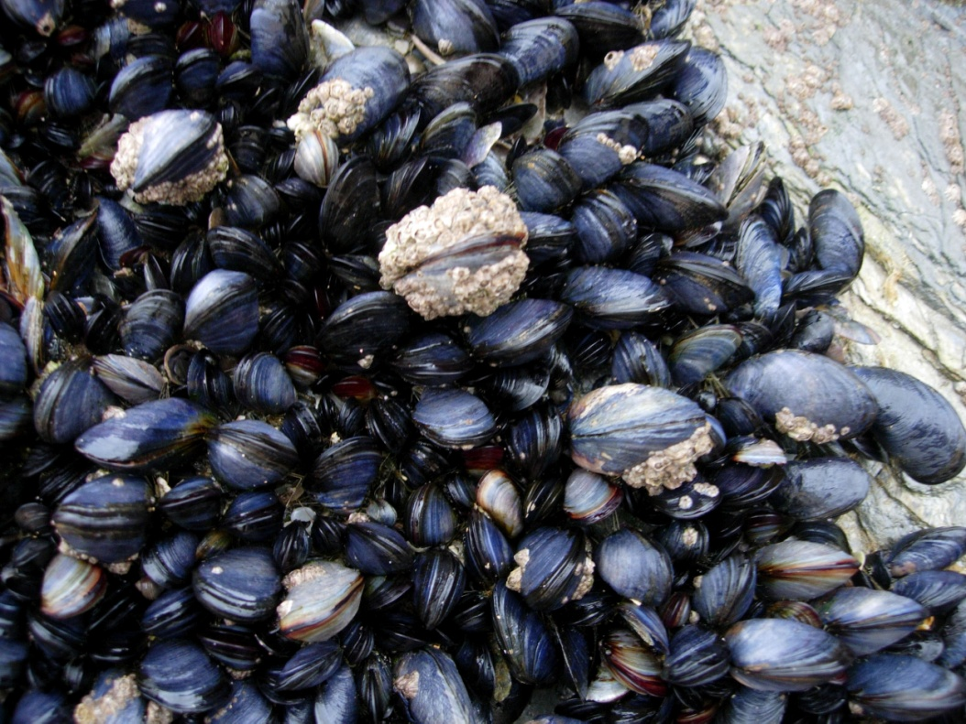
Mussles
Strong attachment to rock- Bises hairs.
Ability to open and close shell to avoid desiccation/ feed/ avoid predation.
Free swimming larvae
Cant withstand high
temperatures

